Slide 1
Raspberry Pi Cameras

Slide 2
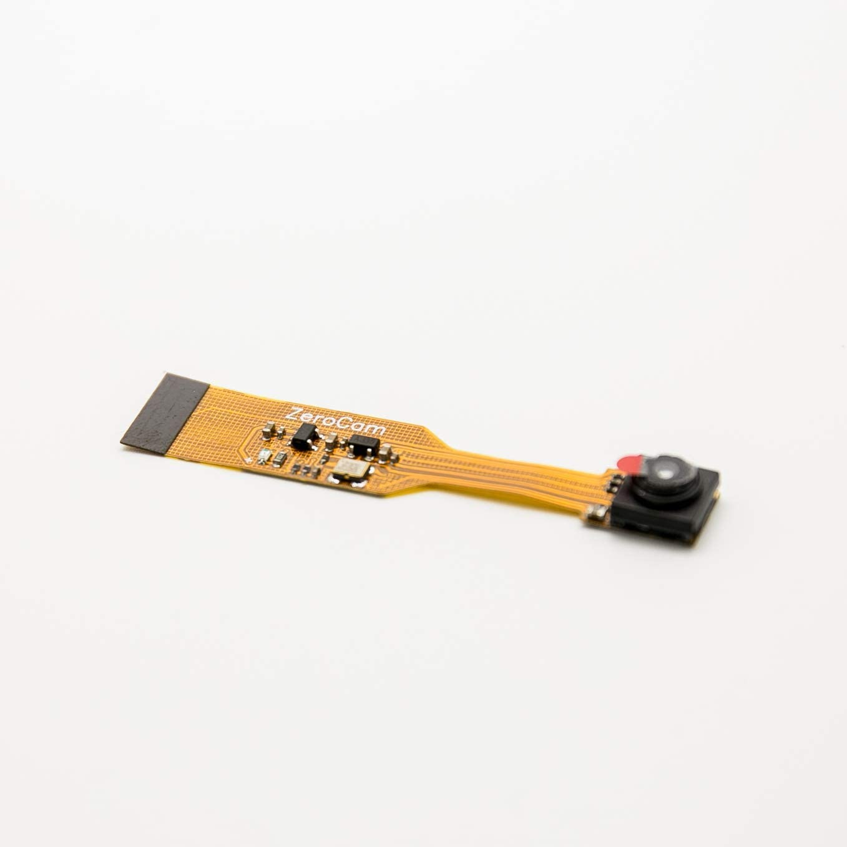
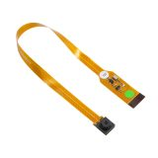
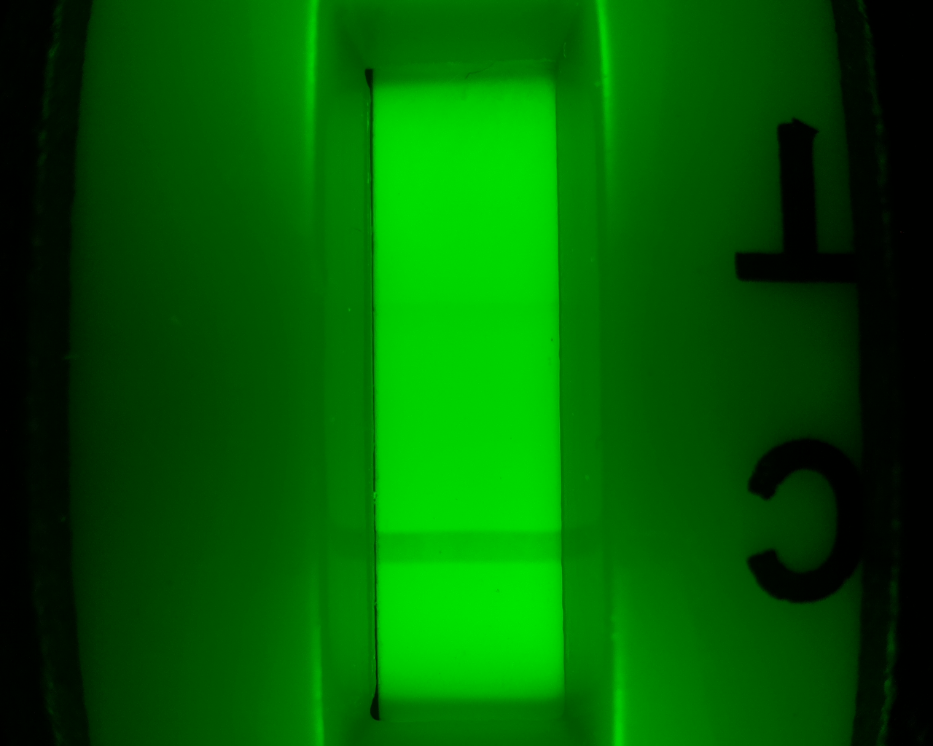
Arducam OV5647 120° mini-camera
for Pi Zero used in single strip reader $17

Slide 3
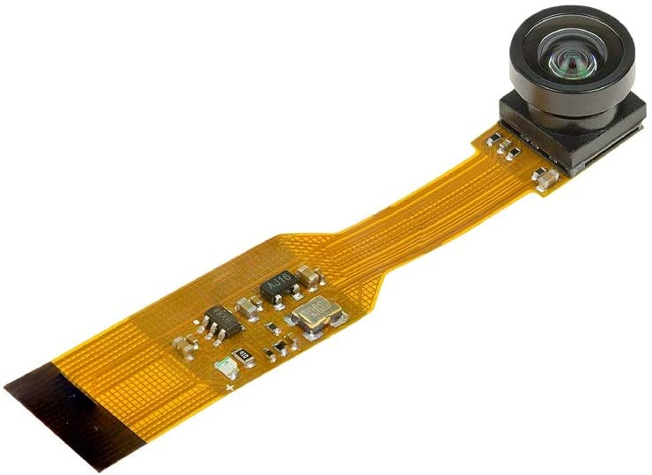
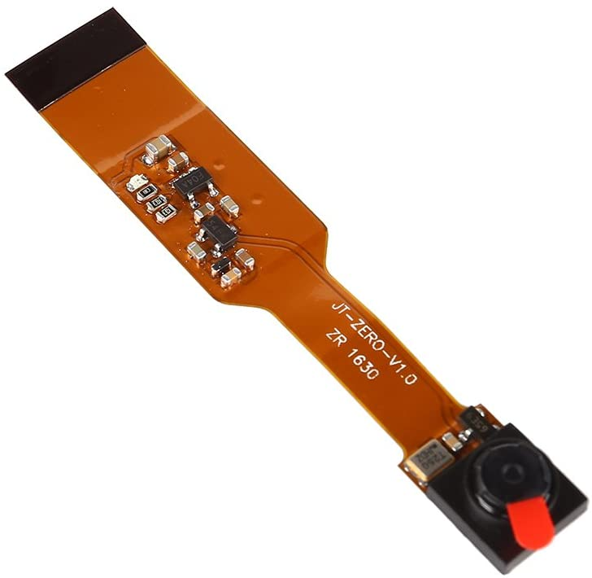
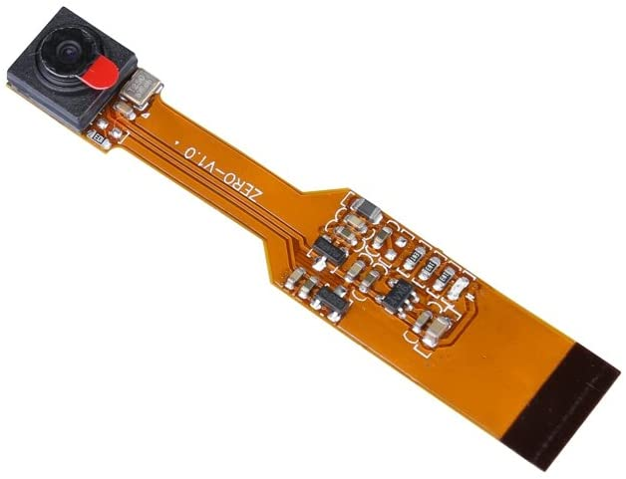
Rejected mini-cameras
Arducam 160 deg OV5647 fish-eye
Original cameras, sainsmart & unistorm, not easily focused:

Slide 4
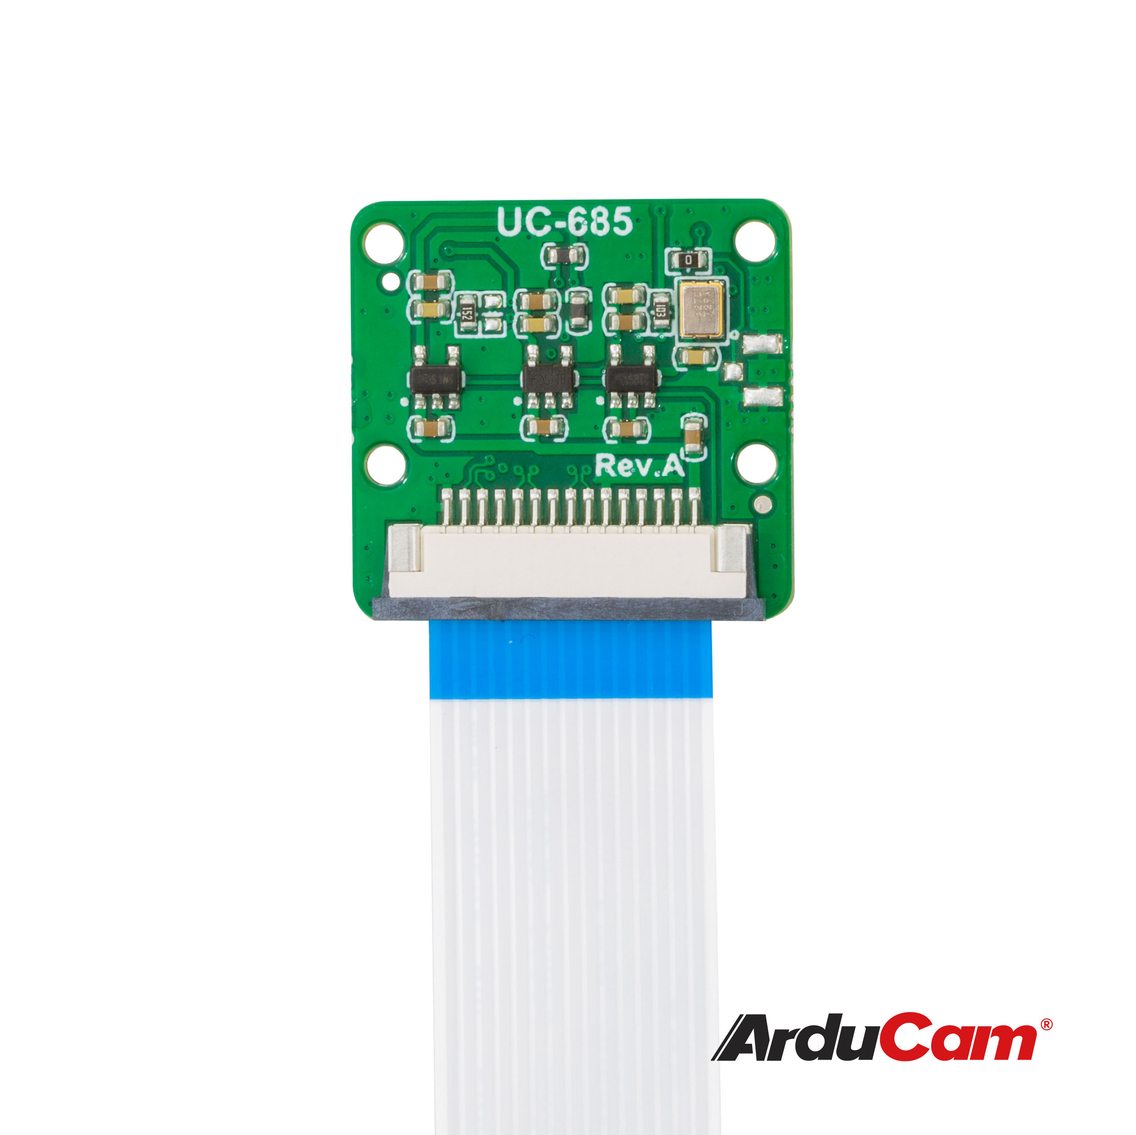
5MP Arducam Autofocus camera
used in 8-strip reader $15
Original was UC-420
New version is UC-685
will not ‘remember’ focus position, so need to set every time
https://github.com/ArduCAM/RaspberryPi

Slide 5
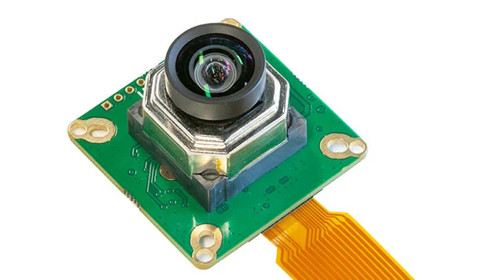
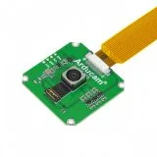
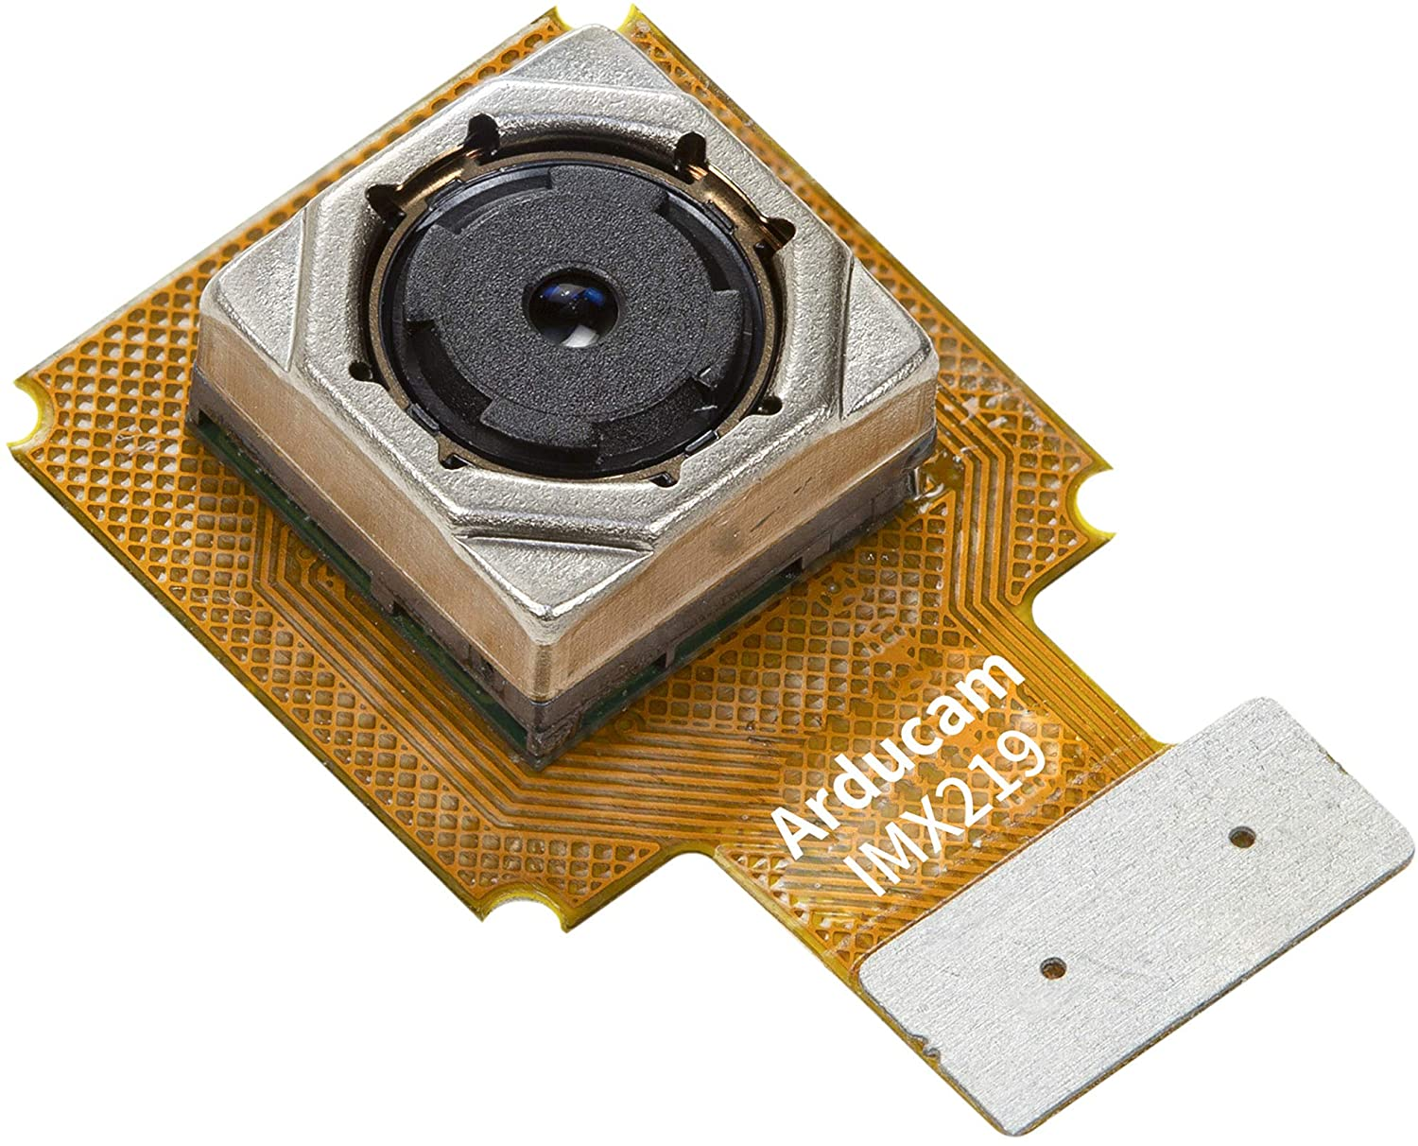
Rejected 8-strip reader Cameras
Arducam IMX477
could not get to work
Arducam UC-572 16MP MIPI
could not get to work
Arducam IMX219 8MP autofocus:
same as 5MP interface! Same quality.
Could be used, but more expensive ($55)

Slide 6
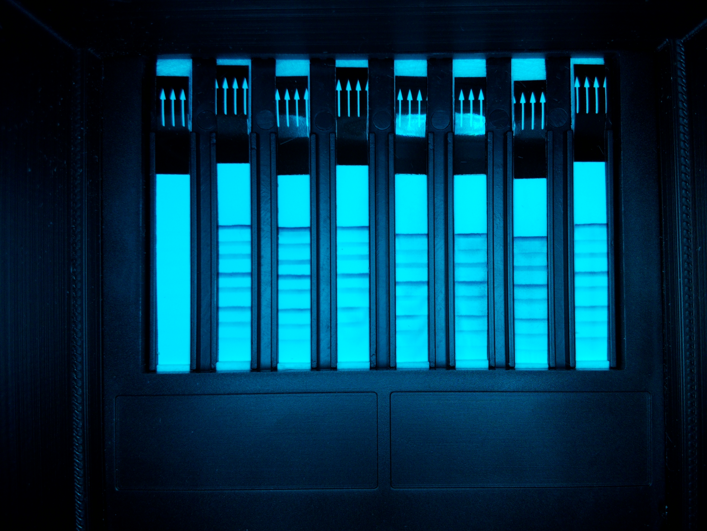
Arducam IMX219 8MP Autofocus
replacement for Pi V2 camera plug-in module, so total cost is $25 + $30 (V2 Cam)
same quality as 5MP, but more pixels (extra pixels not needed with current algorithm).

Slide 7
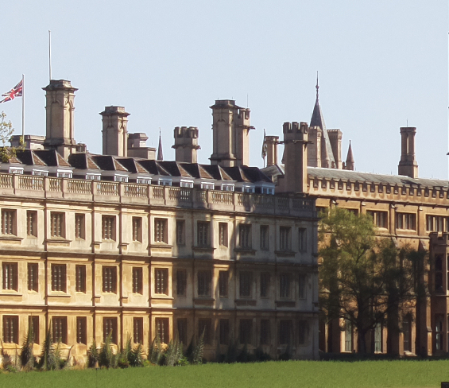
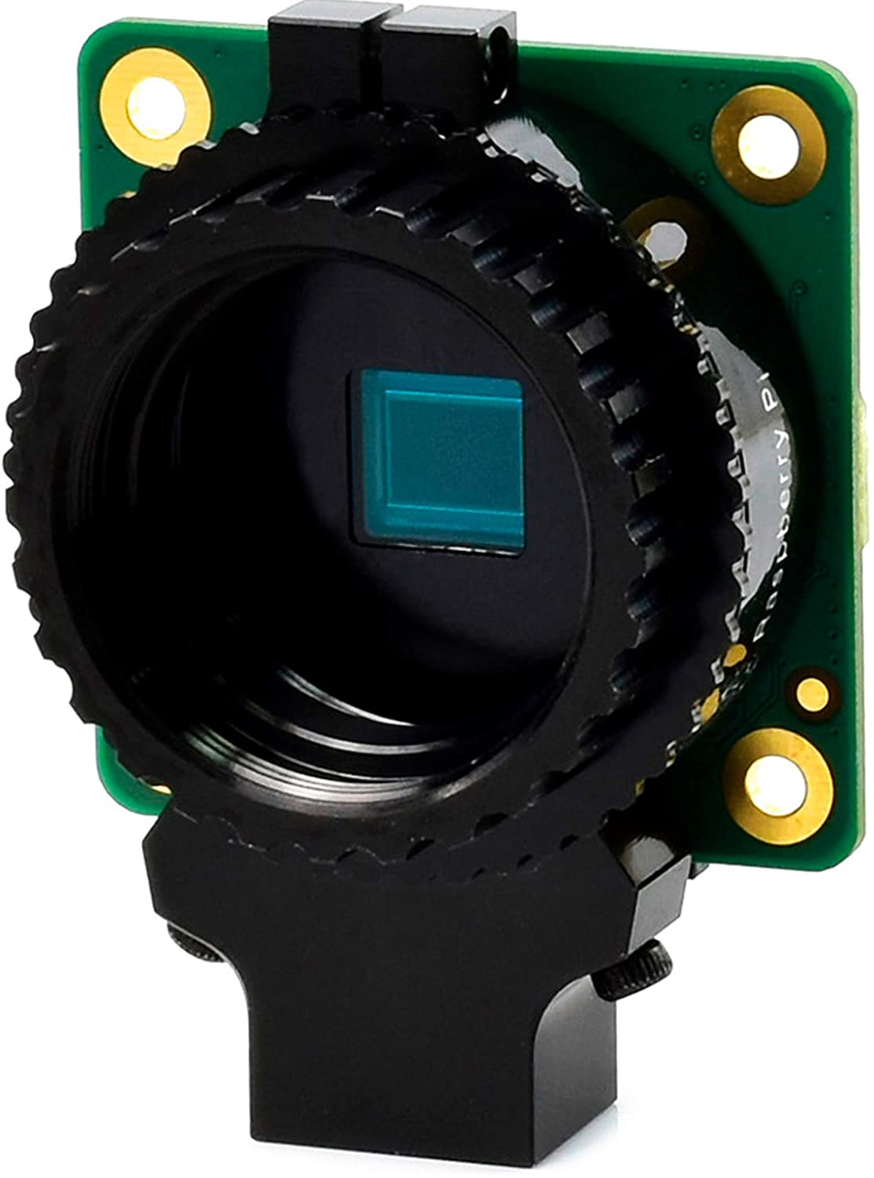
Pi HQ (High-Quality) Camera
$50 comes without lens
12.3MP max resolution, requires separate lens
Use C mount lens (adapters available)
1/10 image crop, good detail:

Slide 8
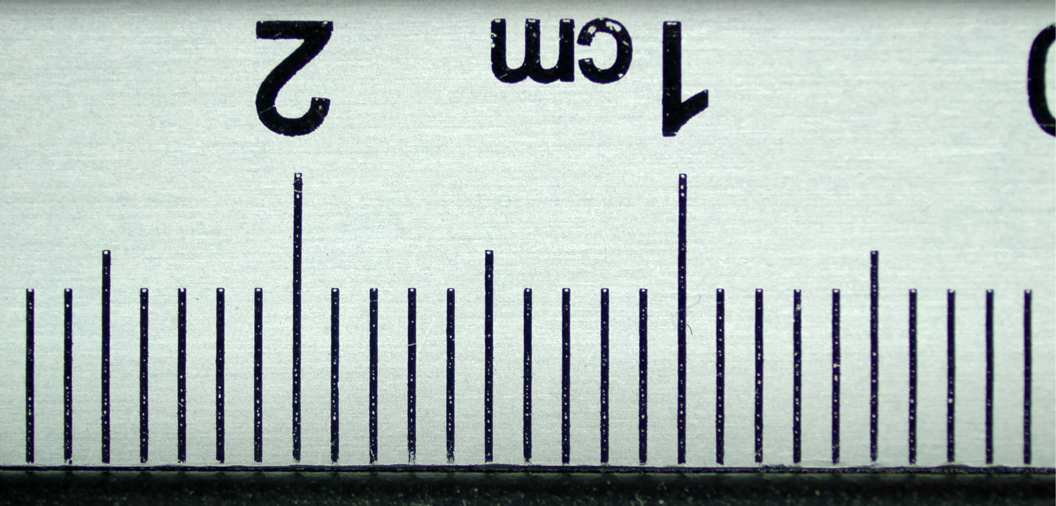
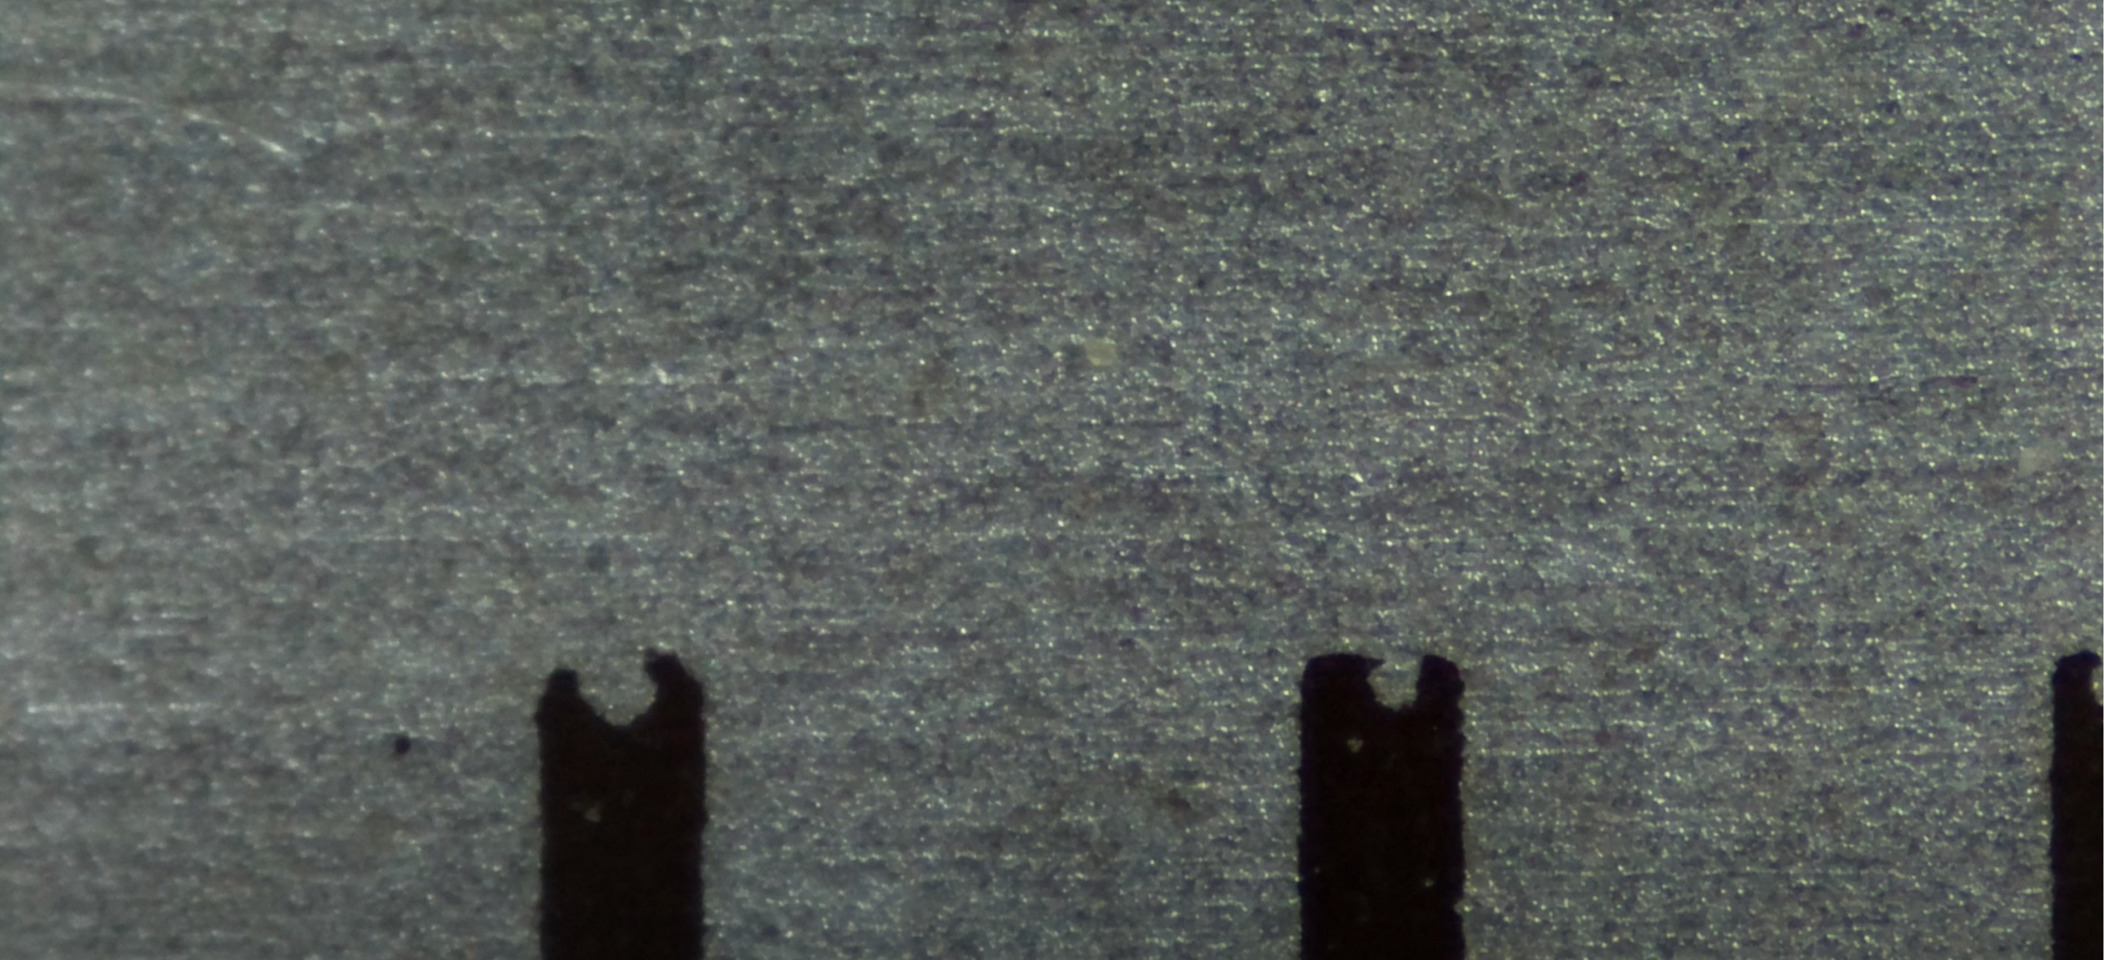
Pi HQ Camera
w/300X microscope lens
Min:
Max:

Slide 9
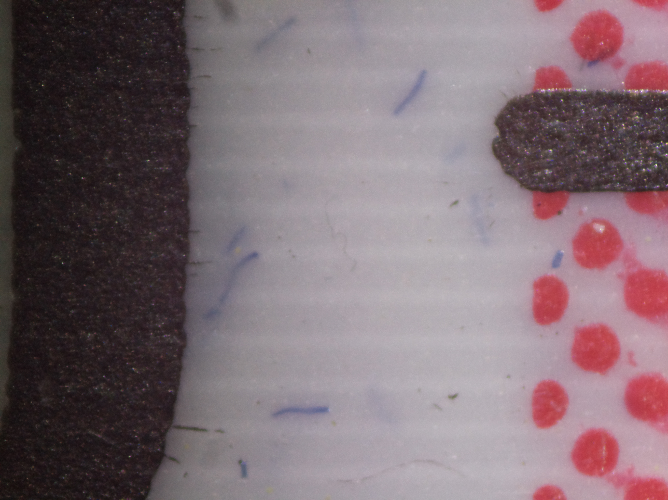
Pi HQ (High Quality) Camera
with 300X microscope lens ($78)
My 300x HQ had scan lines, might be bad camera or connection or settings

Slide 10
Pi HQ Camera w/300x lens
seaweed

Slide 11
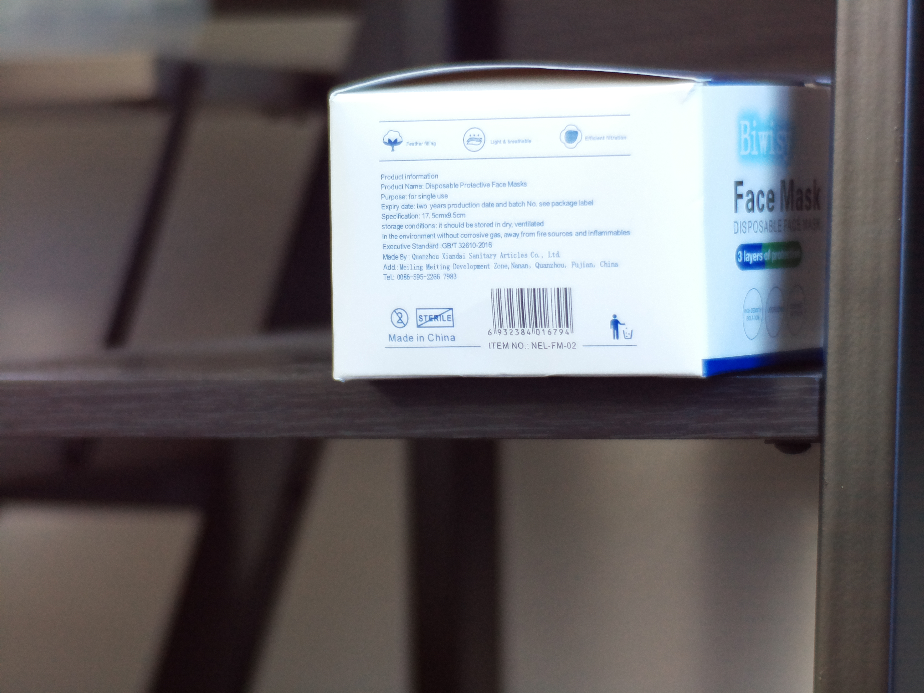
Pi HQ w/Silver 35mm F1.6
CCTV C-Mount Lens (from Amazon $16.74)

Slide 12
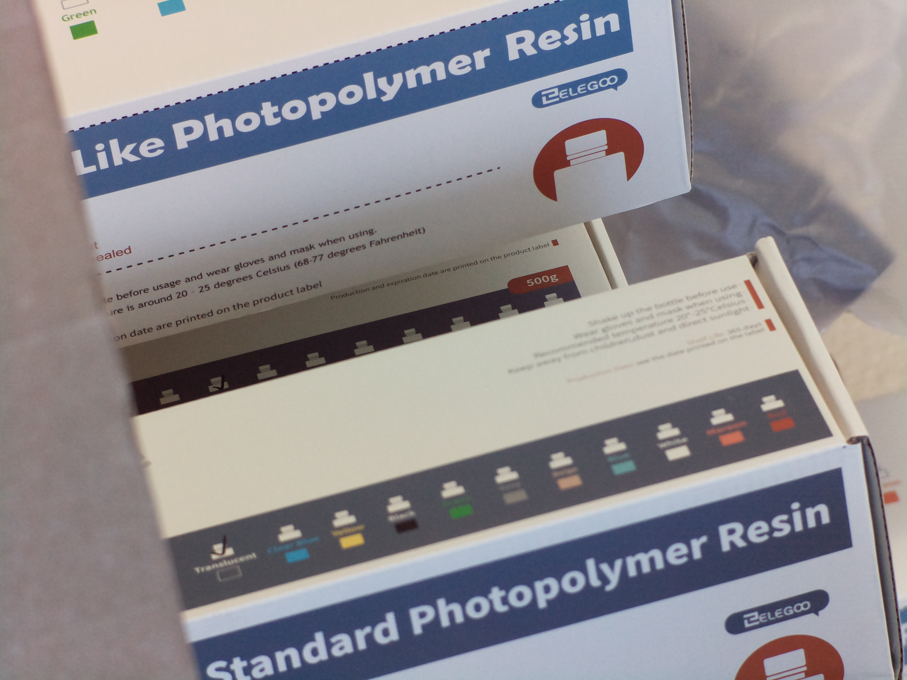
Pi HQ w/Silver 35mm F1.6
CCTV C-Mount Lens

Slide 13
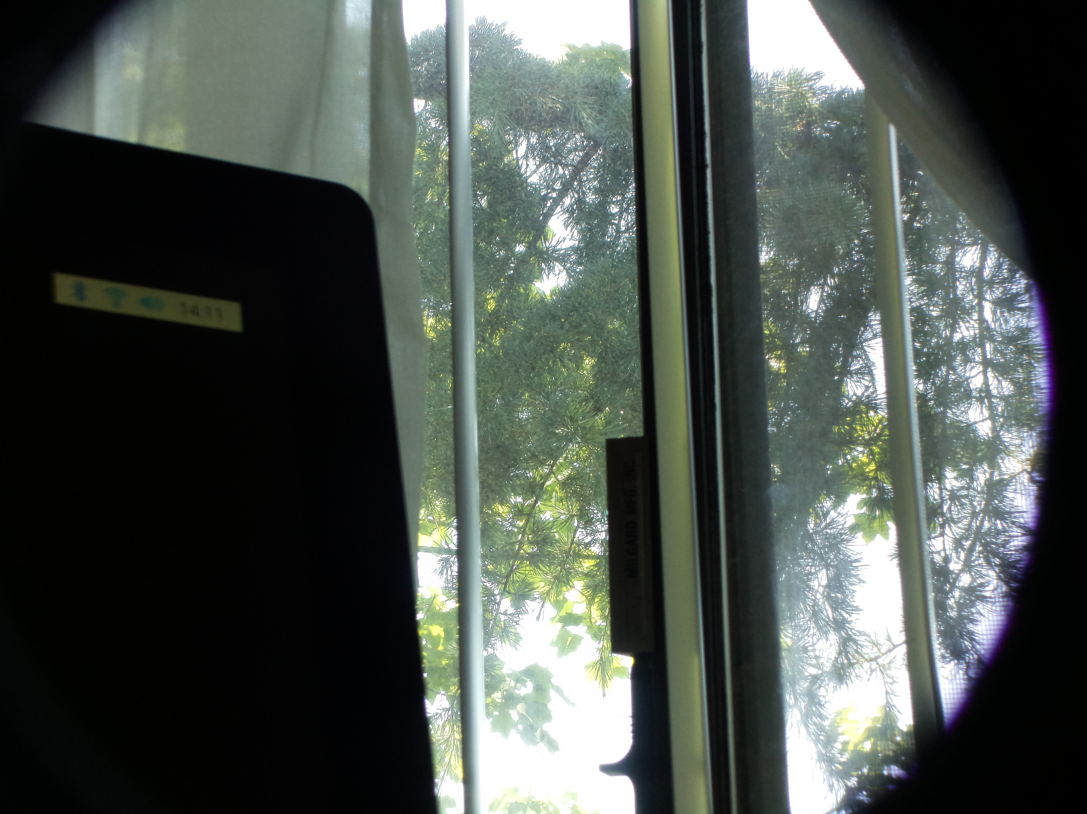
Pi HQ camera w/OWSOO Lens $50
5-100mm CCTV Lens,CS F1.8 Lens

Slide 14
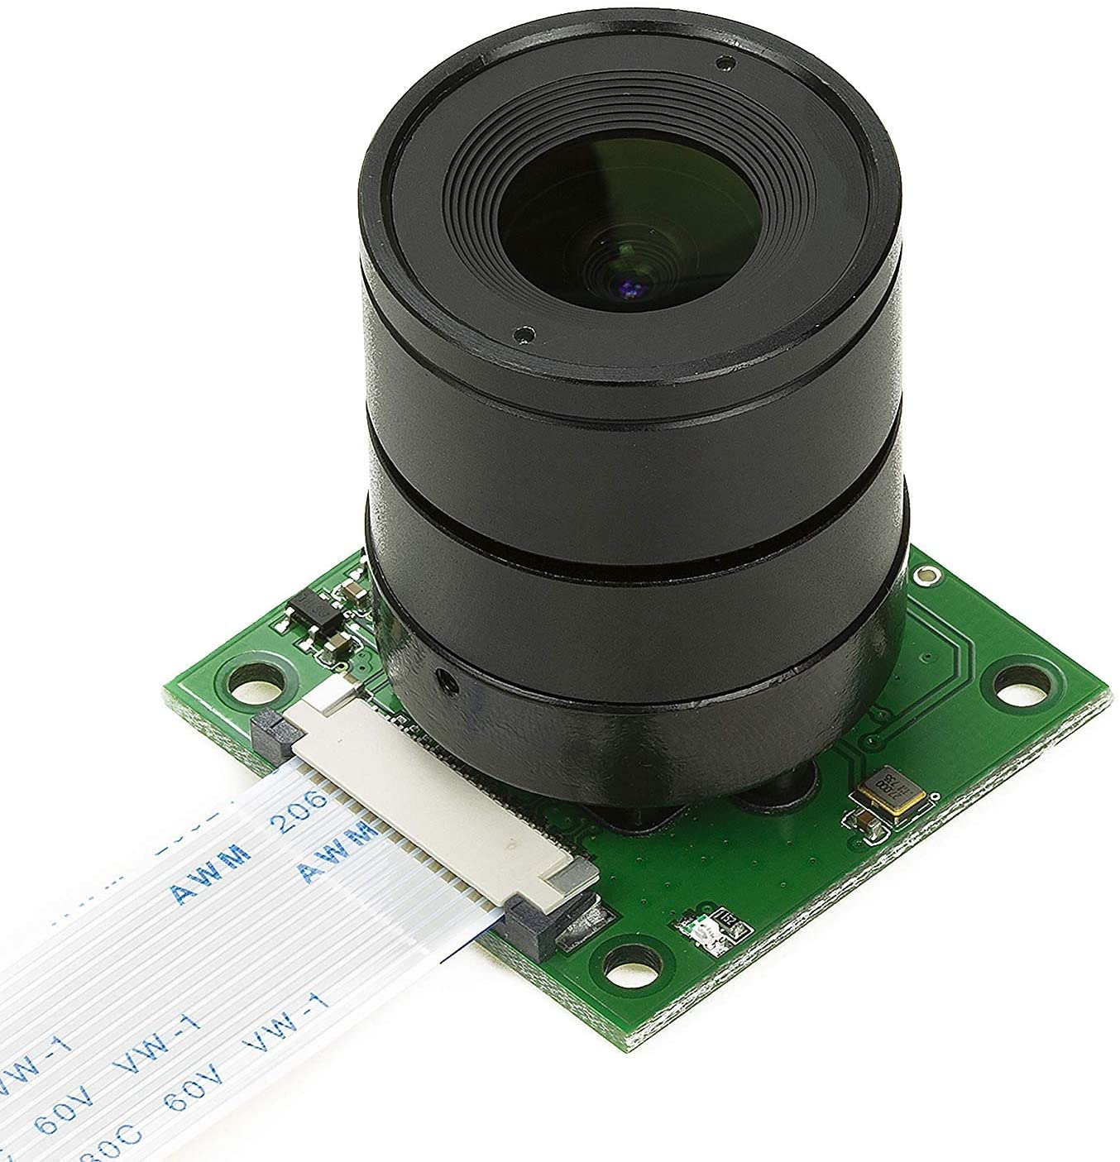
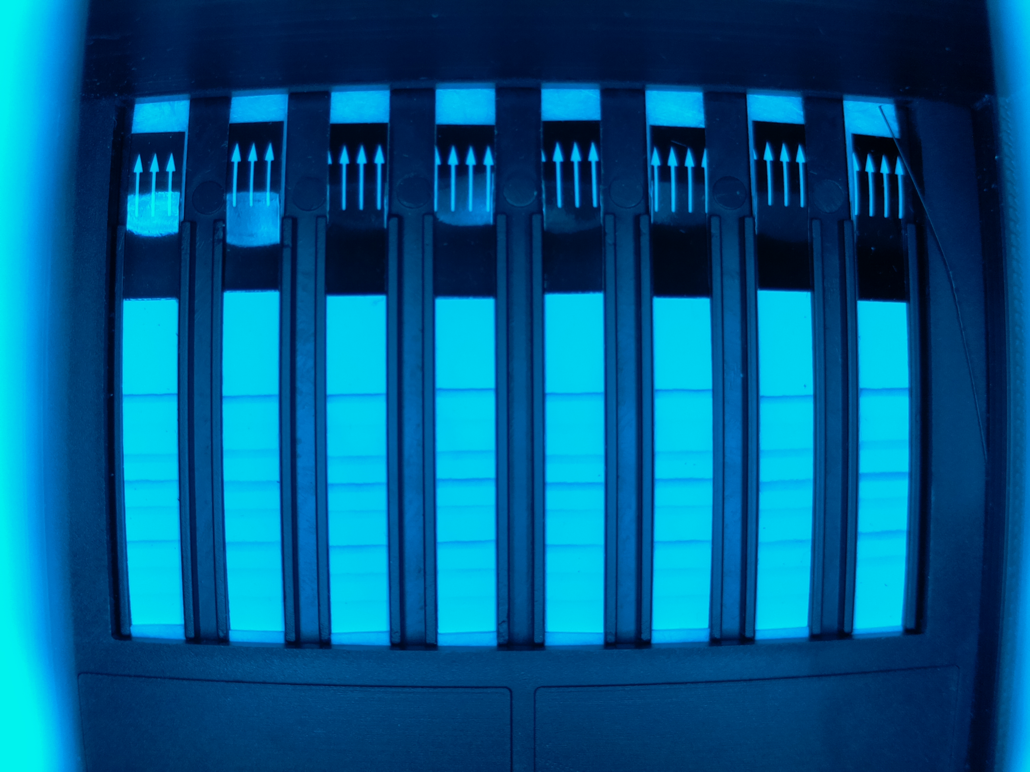
Arducam UC-261
5MP OV5647 $30
no autofocus motor
Fisheye CS Mount lens - can be changed out

Slide 15
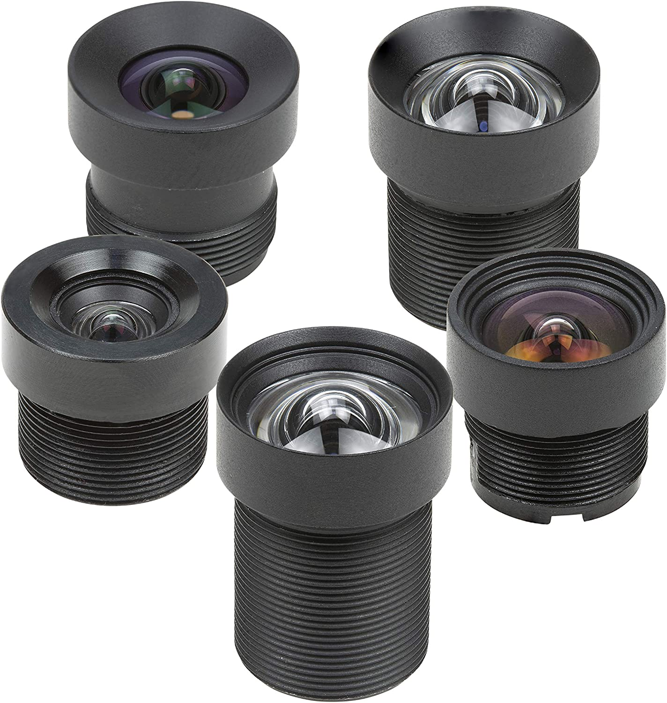
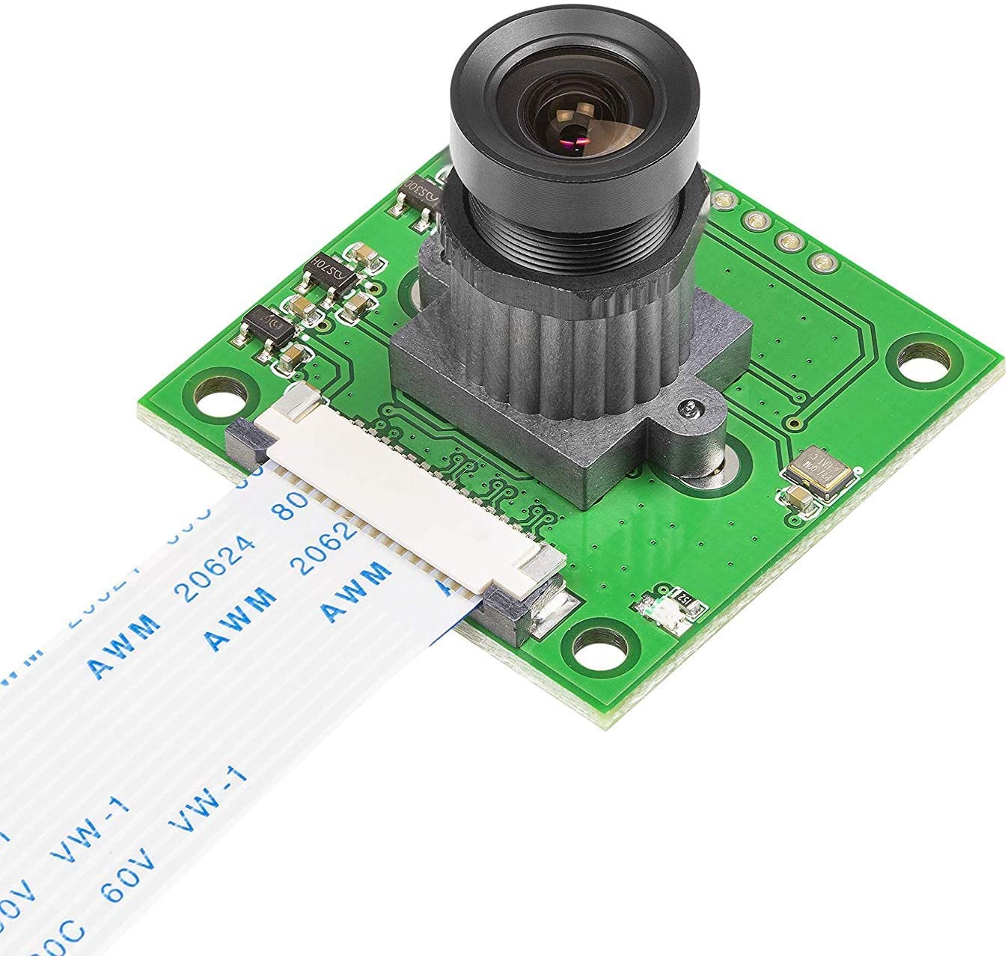
Arducam M12 interchangable lenses, low distortion

